Slide 1

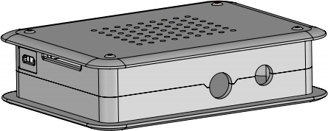

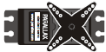


Realtime
Operator
sixaxis
gamepad
Raspberry Pi
WL_Joystick
sixaxis2u_alpha_omega
switch
u_alpha_omega2pwm
FPGA
servo1
CS1E_controller
servo2
VeriStand
workspace
Oqus
servo3
servo4

